Slide 1
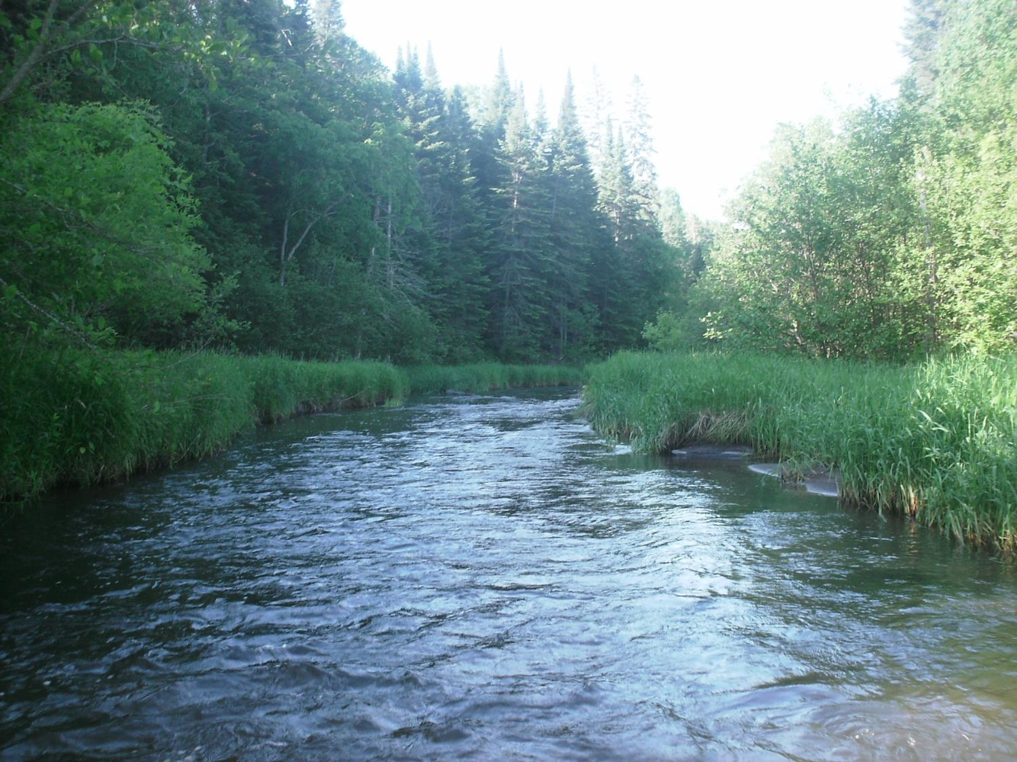
Legislative Water Commission
September 17, 2018
Co-chairs: Senator Wiger Representative Torkelson
Jim Stark, Director
Straight River, Becker County
1

Slide 2
Legislative Water Commission
Monday, September 17, 2018 (1 pm
State Office Building: Room 10
Rep. Paul Torkelson, Chair * Sen. Chuck Wiger, Co-Chai*
* Presiding
Agenda
Approval of minutes– August, 2018
Water Issues Presentation: Cooperative Stream Gaging Programs: James Fallon (USGS) and Greg Kruse (MNDNR)
2019 LWC Recommendations and Process-Jim Stark
Review of Clean Water Fund Meeting - Jim Stark
Future meeting discussion
Adjourn
2

Slide 3
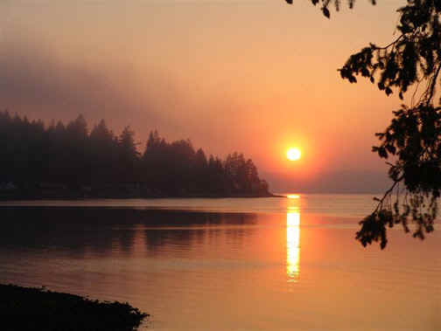
Water Issue Presentation
DNR and USGS stream gaging program– How are these data used? How are they coordinated?
James Fallon (USGS)
Greg Kruse (DNR)
Notes:
For more information and real time monitoring data you can visit this web site.

Slide 4
Questions?
4

Slide 5
2019 Legislative Issue and Recommendation Process
Notes:
For more information and real time monitoring data you can visit this web site.

Slide 6
Process Based On:
Commission guidance
Stakeholder suggestions
Reviews of documents
Background papers
Draft recommendations
Stakeholder meetings
Consolidating comments
Commission consensus
Legislative discussions
Notes:
For more information and real time monitoring data you can visit this web site.

Slide 7
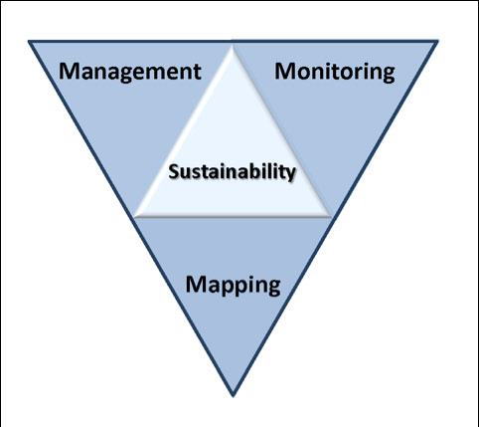
Six issues
Topical areas
Wastewater*
Drinking water*
Groundwater
Sustainable Lakes
Water retention
Future state
* Short term
Notes:
Protection of ground water and surface water resources will require substantial investments from a diversity of funding sources over all levels of government during the next decade. As a part of this effort, this program of mapping, monitoring and managing is necessary to deliver the basic understanding of the hydrologic system for both surface and groundwater.

Slide 8
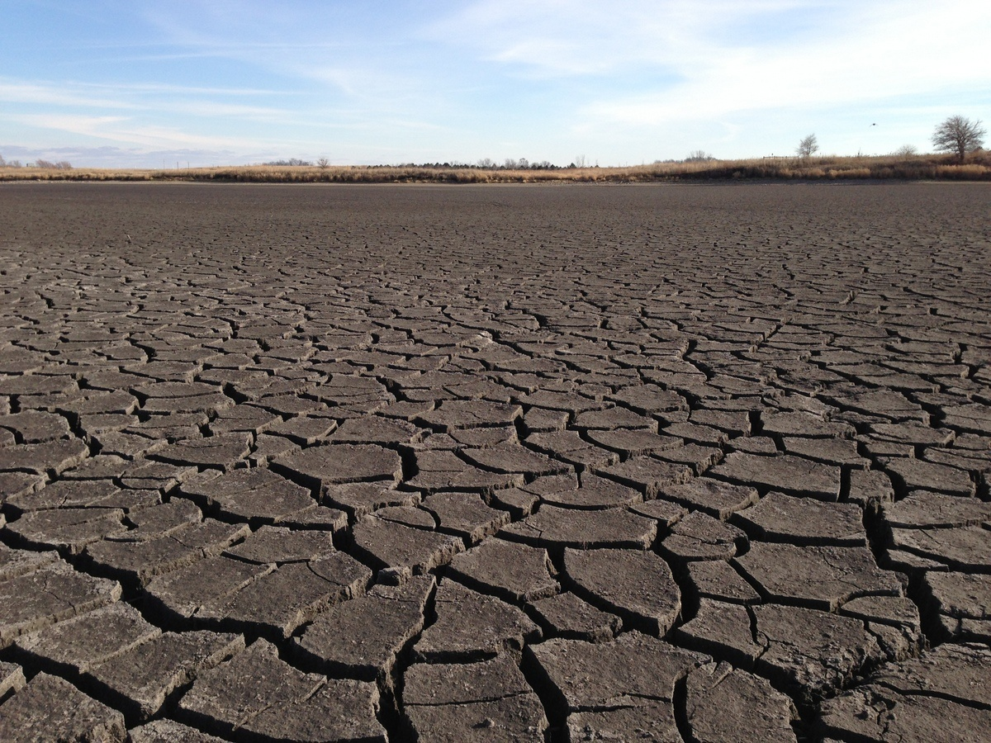
A Firm Foundation
1989- GW Act
1999- USGS Sustainability Report
2004- G16 Impaired Waters Plan (MPCA)
2005- DNR/GW Report
2006- Clean Water Legacy Act
2006- ENRTF Sustainability Report
2008- Clean Water Amendment
2008 Legislative Water Sustainability Framework
2009- EQB Sustainability Report
2012- GW Management Area Plans (DNR)
2017- Freshwater Society Reports on Water Sustainability
(Worthington, MN-2012)

Slide 9
How can the recommendations be used?
Propose/promote/support legislation
Consultation with Legislative Committees
Resource for stakeholders- legislative initiatives
Guidance for budget decisions
Recommendations to guide or suggests programs/planning/funding:
LCCMR
LSOHC
CWC
Agencies/Governor’s Office

Slide 10
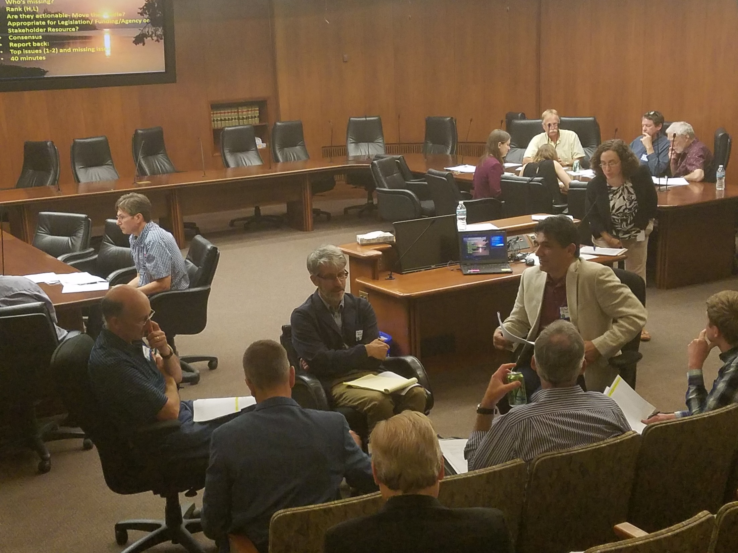
Five Stakeholder Meetings

Slide 11
Resources:
Draft recommendations
Background issue paper with details
Notes:
For more information and real time monitoring data you can visit this web site.

Slide 12
Stakeholder Process
Discuss recommendations
What’s missing?
Rank (H,M,L)
Are they actionable- Move the needle?
Appropriate for Legislation/ Funding/Agency or Stakeholder Resource?
Small Group Report back:
Top issues (1-2) and missing issue
Notes:
For more information and real time monitoring data you can visit this web site.

Slide 13
Example: Groundwater – Ranked Recommendations
Recharge and re-use
Data, Information and Analysis
Protect vulnerable aquifers
Water Bank Accounts
Analysis and Modeling
GW/Surface Water Interactions
Enhance Water Appropriation Process
Economic Analyses of GW
Connections between Hydrology and Aquatic Biology
Economic Importance of Sustainable Water
Legislation: Propose legislation to limit overuse of chloride
Consolidate GW regulations among agencies
Inter-jurisdictional water planning
Establish a Clean Water Council Sustainability Committee
Legislation: over-use of nitrate fertilizer

Slide 14
Six Issues- Top Few Priorities
14

Slide 15
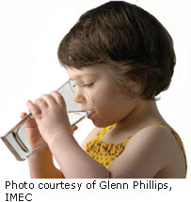
Drinking Water
Continue/improve monitoring and education—DW contaminants
Increase investment in DW infrastructure- asset management plans and targets
Legislation– Accelerate source-water protection for rivers, vulnerable aquifers severing private wells
Notes:
What we hope to leave you with is a much better understanding of our state’s groundwater resources and appreciation for the challenges we face.
Simply stated the problem we are increasingly recognizing is that there are ….

Slide 16
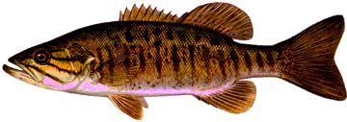
Wastewater and Storm Water
Increase funds for WW infrastructure
Asset Management Program with for WW– establish targets
Pilot watershed trading– with targets
Promote efficiencies--Regional WW treatment
Understanding of the impact of urban storm water retention on GW
Notes:
The issue of interest is the introduction of chemicals into the aquatic environment that can affect aquatic organism or human health. For instance some of the chemicals analyzed act as endocrine disruptors—that is act to change the normal function of the endocrine system in animals.

Slide 17
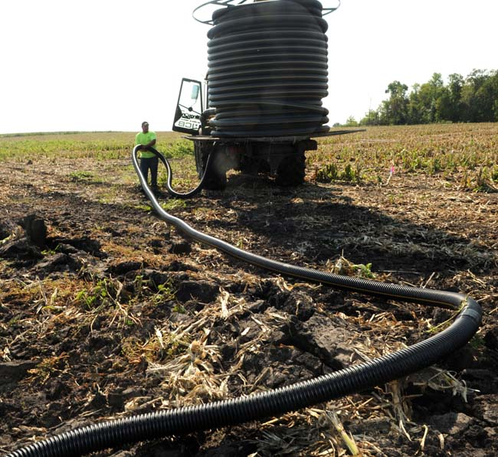
Keeping Water on the Land
Determine drainage’s impact on GW
Determine extent of tile drainage
Is drainage is shifting water balances?
ROI for various BMPs
Use 1W/1P to site BMPs in the right places
Establish water retention targets

Slide 18
Groundwater Sustainability
Maintain/enhance gw information and monitoring
Determine water bank account balances
Establish sustainability targets based on “bank accounts”
Protect “source water” including vulnerable “domestic well” aquifers
Reduce chlorides–need targets
Reduce Nitrates—need targets

Slide 19
Protecting our Lakes
Legislation: reduce chloride application– set targets
Accelerated programs for conservation easements--lakes needing protection—prioritize
Assess lakes and focus management priorities for sentinel lakes recognize, recognize future
Notes:
For more information and real time monitoring data you can visit this web site.

Slide 20
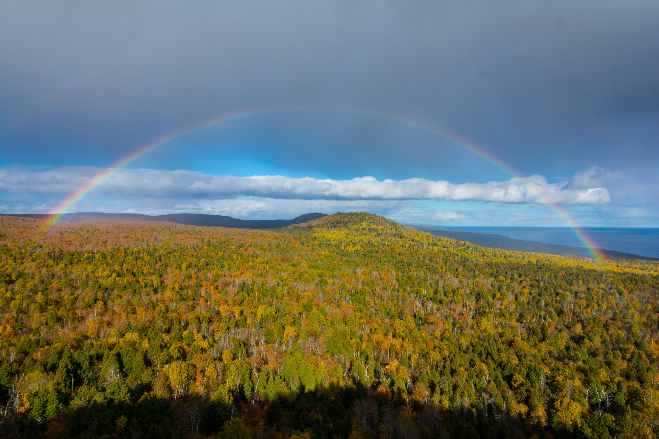
Future State for Water
Maintain and enhance water monitoring and information
Increase public education
Establish firm goals and targets
Provide incentives for the “right” BMPs
Targets based on water bank accounts
Plan for change
Enhance water appropriations process
Notes:
to the northern forests

Slide 21
Common Themes
We need to think long term and short term
Establish targets--measure and assess change
Mange adaptively
Move from assessment to implementation
Work within existing state programs and agencies
Implement locally
Assess progress
Notes:
For more information and real time monitoring data you can visit this web site.

Slide 22
LWC Synergy with Other Efforts
CWC- UM Natural Capital project
MDH- UM Future of Drinking water Assessment
Met Council- Metro Water Planning Program
Notes:
The issue of interest is the introduction of chemicals into the aquatic environment that can affect aquatic organism or human health. For instance some of the chemicals analyzed act as endocrine disruptors—that is act to change the normal function of the endocrine system in animals.

Slide 23
Next Steps
Revise Issue Statements
Revise Recommendations
Initial Consensus from LWC
Feedback from Stakeholders
Consolidate recommendations into recommendation themes
Commission Consensus
Recommendations to Legislature
Legislative briefings with Environmental Committees/Agency staff

Slide 24
Clean Water Council Update: Jim Stark
24

Slide 25
2018 Meeting Schedule
Second round of stakeholder meeting-- October
Future LWC meetings: Discuss meeting times
October 15 @ 1 pm ( Recommendation consensus_
November 13 ( Recommendations to Legislature)
December 10

Slide 26
Thanks!
Notes:
For more information and real time monitoring data you can visit this web site.

